Slide 1

TABLEAU GUIDED PROJECT: COVID IN ITALY

Slide 2
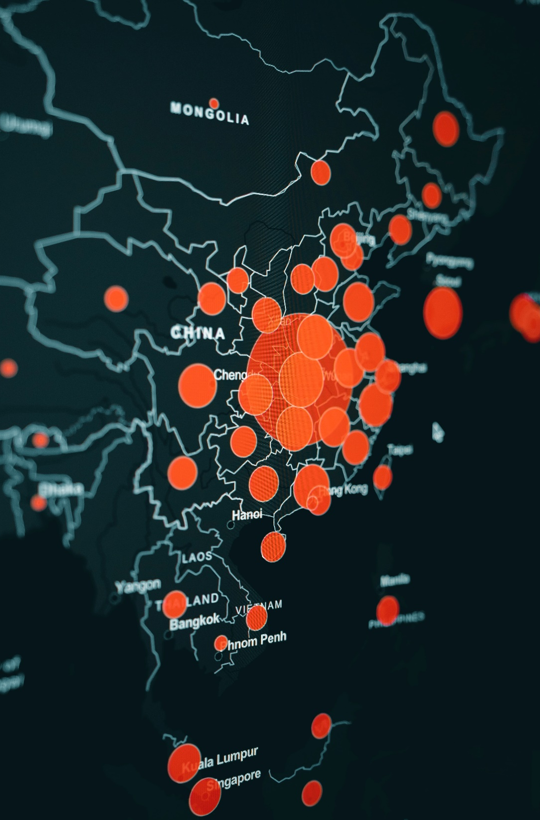
Tableau
Tableau is a data visualization tool that is easy to use, flexible and very powerful

Slide 3
LETS LOOK AT THE DATA

Slide 4

THE DATA
The impact of COVID-19 on Italy by Province (and Region)
Dataset and accompanying Tableau workbook will be available at
github.com/shuvo-saha/tableau-italy

Slide 5

OUR TASK
Make a dashboard summarizing the impact of COVID 19 on Italy and derive useful insights

Slide 6
WHERE DO WE GO FROM HERE?

